Slide 1
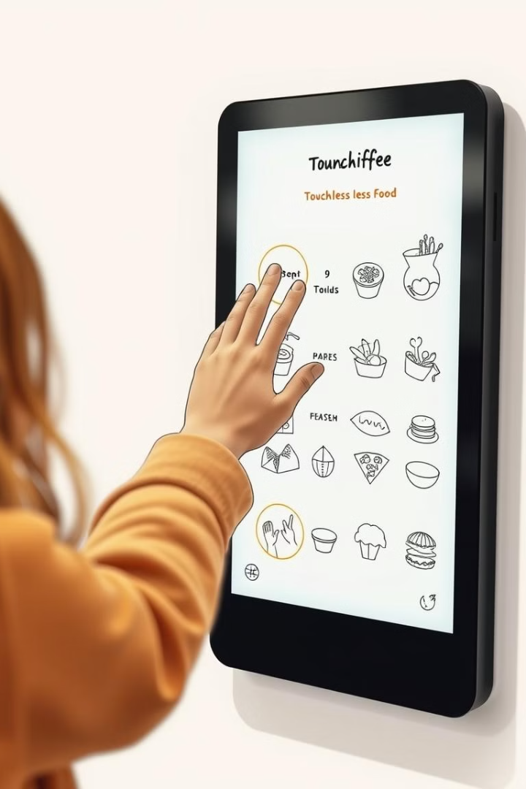
Gesture-Based Food Ordering: HCI Using OpenCV and Mediapipe

Slide 2
The Need for Touchless Interfaces
Hygiene
Accessibility
Touchless interfaces minimize physical contact. This reduces the spread of germs. It's especially important in food service.
Gesture control provides hands-free interaction. It benefits users with mobility challenges. It offers greater convenience.

Slide 3
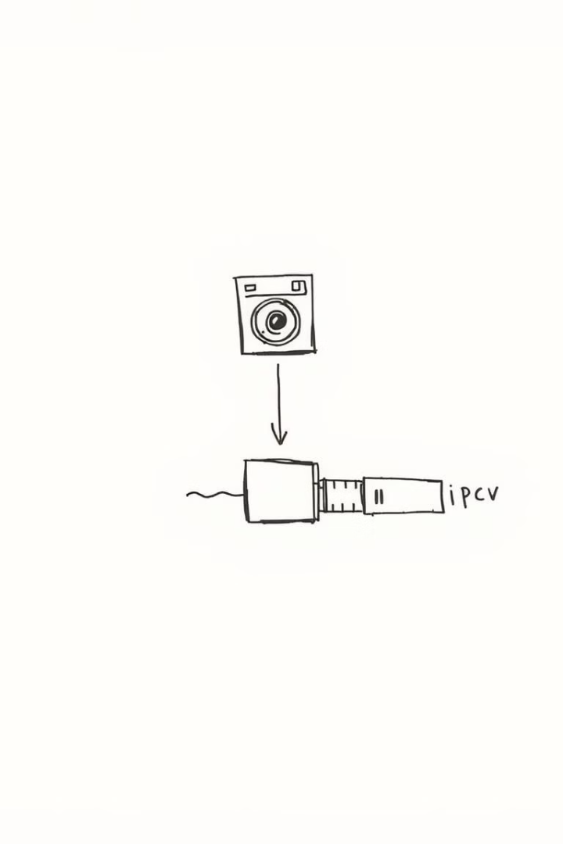
OpenCV and Mediapipe: The Technical Foundation
1
OpenCV
OpenCV is used for real-time image processing. It provides tools for capturing and analyzing video input. It's essential for gesture tracking.
2
Mediapipe
Mediapipe offers pre-trained machine learning models. It accurately detects hand landmarks. It facilitates gesture recognition.

Slide 4
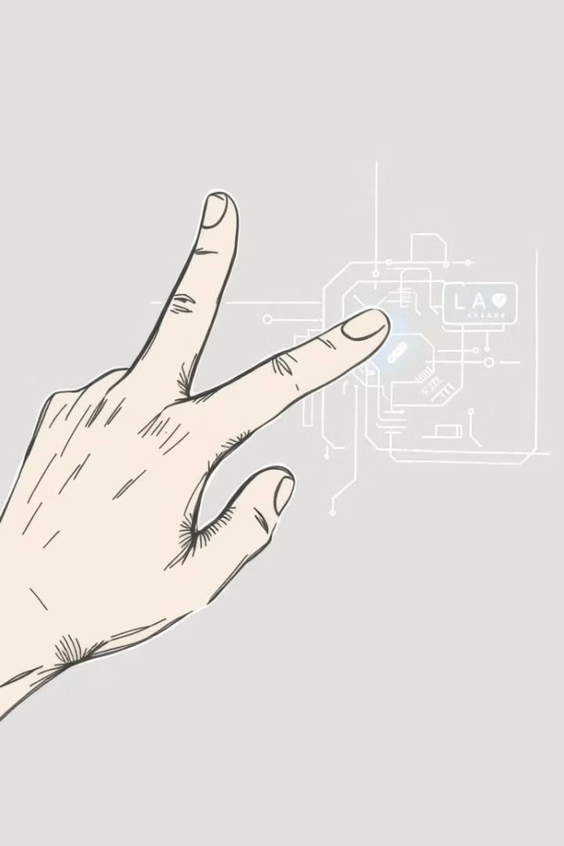



Gesture Recognition Implementation
Action Capture
Capturing hand movements using OpenCV.
Command Conversion
Converting actions into specific commands.
Execution
Executing the commands on the website.

Slide 5
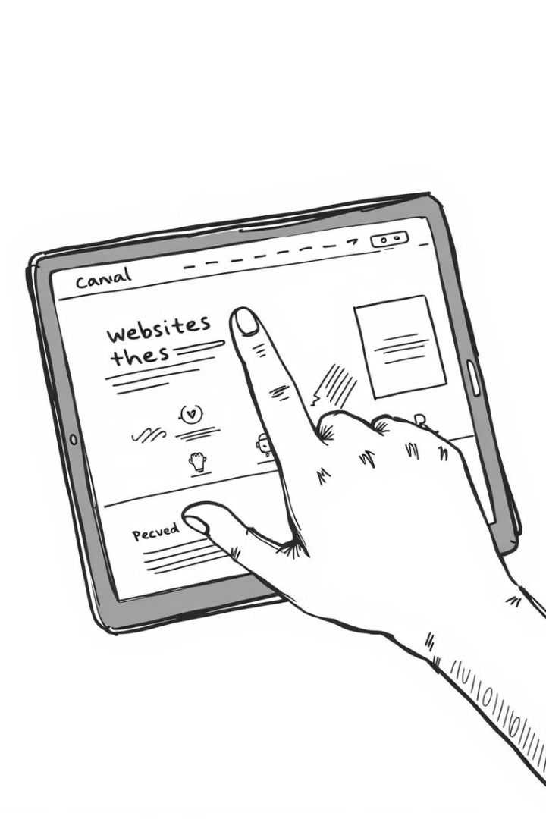
Website Navigation via Gestures
Scrolling
Selection
Users scroll through menu options with hand waves.
Specific gestures select items for ordering.
Confirmation
Gestures confirm and finalize the order.

Slide 6




Ordering Food with Gestures
Initiate
1
Browse
2
4
Confirm
3
Select
This demo showcases the practical application of the gesture-based system. See how users can effortlessly order food hands-free. It's innovative and intuitive.

Slide 7
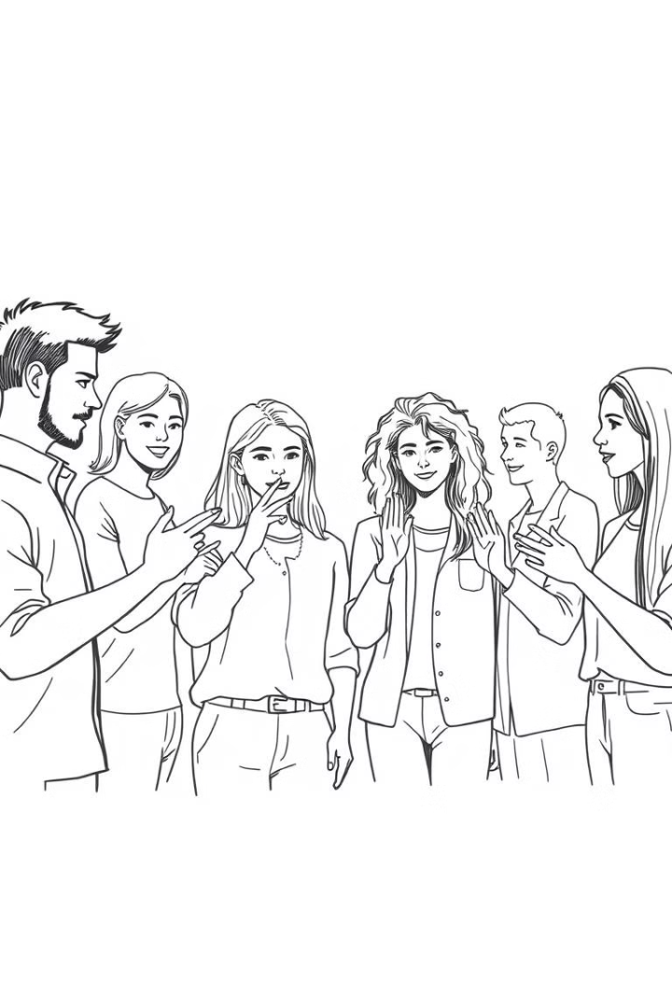



Benefits and Advantages
Hygiene
Accessibility
Efficiency
Reduces contact, promoting cleanliness.
Offers easier use for all individuals.
Streamlines the ordering process.

Slide 8
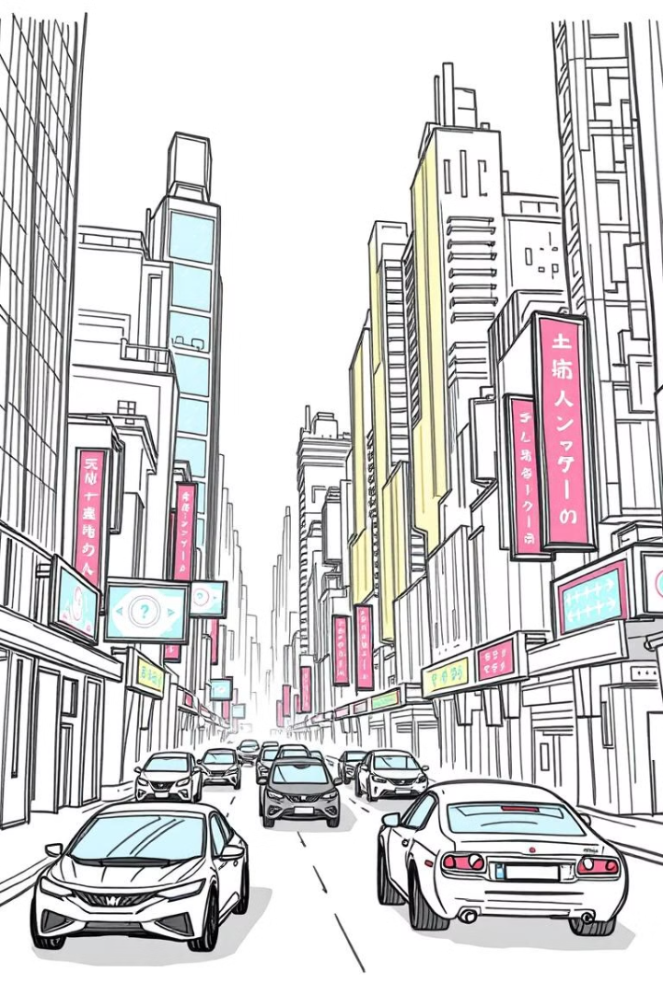
Future Scope and Conclusion
Gesture-based HCI offers vast potential for various applications. Expanding to more complex commands and integrating with other systems is possible. This technology is set to revolutionize how we interact with computers.

